Slide 1
By Dahu
E-GOODS

Slide 2
Theme
A website gives us a platform which we can exchange our goods with other people’s on it.

Slide 3
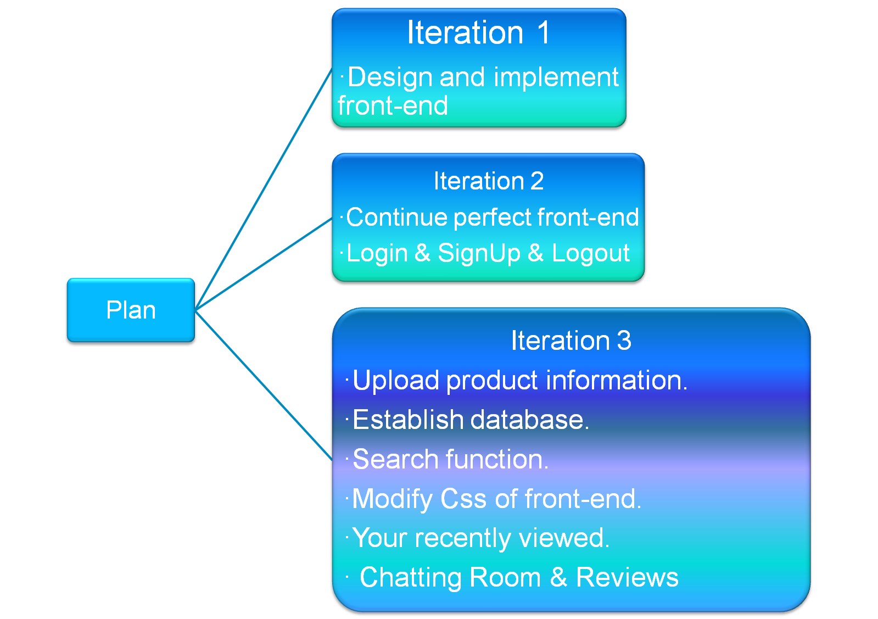

Slide 4
What we have done?
Upload product information.
Establish database.
Search function.
Modify Css of front-end.
Your recently viewed
Chat Room & Reviews

Slide 5
Demo

Slide 6


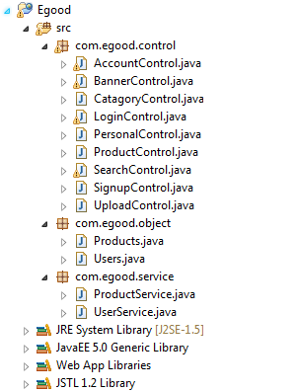
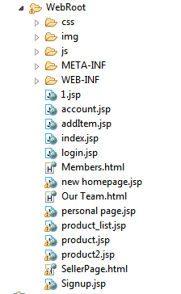
Our website's frame work

Slide 7

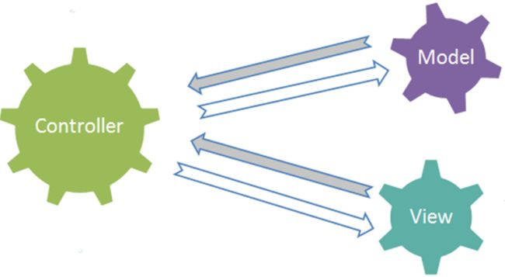

Slide 8



Model

Slide 9
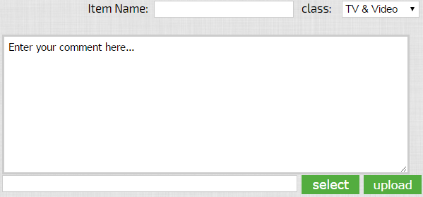

Model .contd

Slide 10
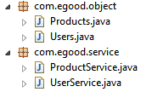
Control
Object, Table
Related Method

Slide 11



View
+
+

Slide 12
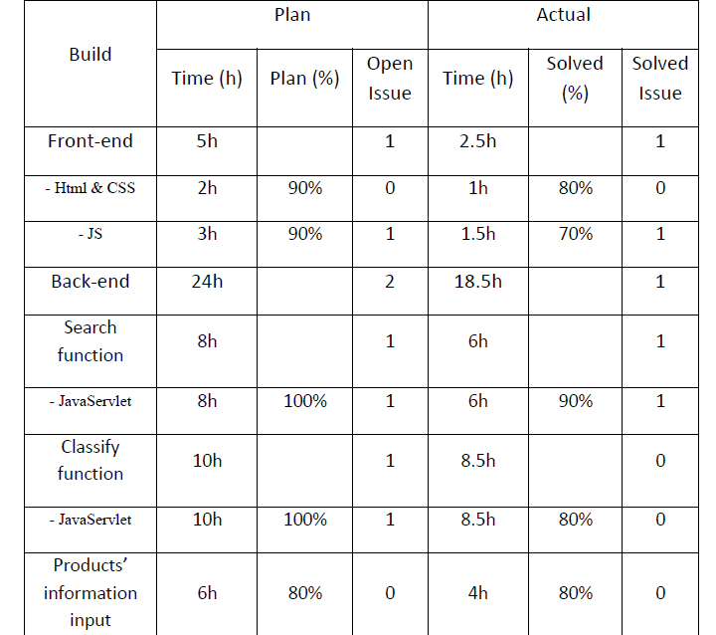
Metrics

Slide 13
Unit Testing
Login ---White box testing
Search---Black box testing
Goods display---Black box testing

Slide 14
Acceptance testing
Browser ：Chrome and IE
Navigation bar in the product list page.
Chat room ----> Email
Review -----> Removed

Slide 15
What we have learned
Github is a good friend.
Make a more detailed plan.

Slide 16
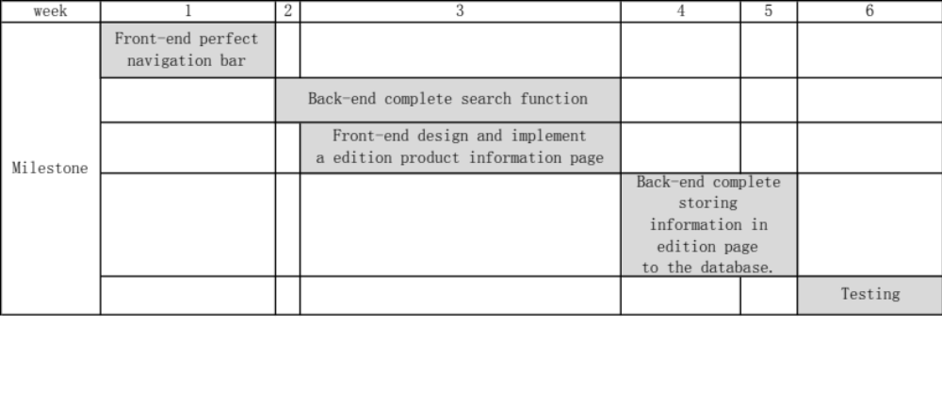
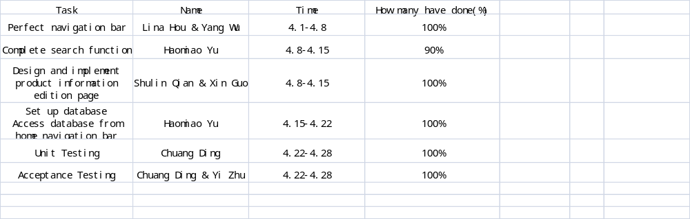

Slide 17
What we have learned
Github is a good friend.
Make a more detailed plan.
Test early and Test often.

Slide 18
Thank You!

